Slide 1
Is Kafka a new JMS?

Slide 2
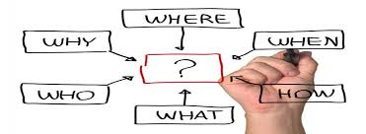
Agenda
1
JMS – How are we using it Today?
2
Common Issues Encountered
3
What is Kafka?
4
Kafka Capabilities
5
Final Comparison - Summary

Slide 3
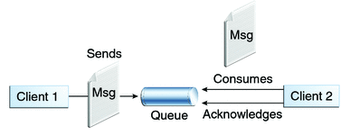
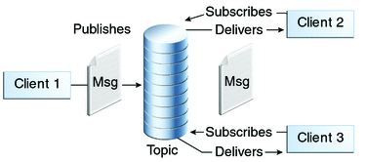
What is JMS? Current MOM Architecture Overview.
Point-to-Point Messaging
Publish/Subscribe Messaging
One Message one Consumer
Sender-Receiver have NO Timing Dependency
Receiver acknowledges successful processing of message
Persistent or Non-Persistent messages.
Consumer can scale.
Same message – multiple consumers
Publishers-subscribers have a timing dependency
Subscriber must continue to be active to get messages.
Option of Durable subscriptions.
Scaling is NOT possible.

Slide 4
Common Issues Observed
M3
M1, M2, M3
M1, M2, M3
M1, M2, M3
B
M3, M1, M2
A
M1
B
A
Topic
C
M2
M3
Multi-Broker HA Cluster
Its hard to maintain sequence in Multi-broker environment.
JMS provides, JMSSequenceID and JMSGroupId, but still its hard to achieve.
Scaling is nearly impossible with Pub-Sub Model.
Hard to maintain sequence
Timing Dependency
No Reprocessing possible.

Slide 5














Kafka Overview
Distributed Streaming Platform
Kafka as a Messaging System
Kafka as a Storage System
Gets benefits of queuing and pub-sub model
Stronger Ordering guarantee
Load Balancing over pool of consumer
Data written to Kafka is written to disk and replicated for fault-tolerance
Allows Producers to wait on acknowledgement - which ensures replication
LONG TERM STORAGE
Kafka for Stream Processing
Kafka Streams API
In Kafka a stream processor is anything that takes continual streams of data from input topics, performs some processing on this input, and produces continual streams of data to output topics.
Streams API for complex transformations
handling out-of-order data, reprocessing input as code changes, performing stateful computations, etc.
DATA PRODUCERS
CONSUMERS
Kafka Connect
Kafka Connect is a framework included in Apache Kafka that integrates Kafka with other systems. Its purpose is to make it easy to add new systems to your scalable and secure stream data pipelines.
STREAM PROCESSORS

Slide 6
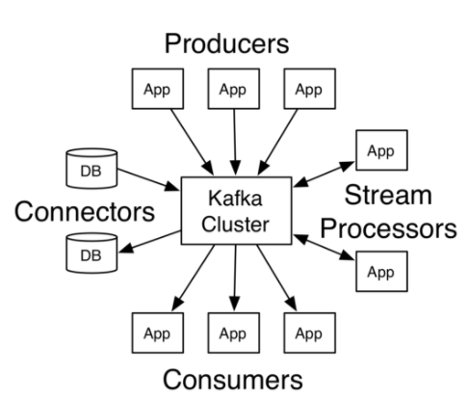
What is Kafka
A streaming platform has three key capabilities:
Publish and subscribe to streams of records
Store streams of records in a fault-tolerant durable way.
Process streams of records as they occur.
Apache Kafka is a distributed streaming platform.
Kafka is generally used for two broad classes of applications:
Building real-time streaming data pipelines that reliably get data between systems or applications
Building real-time streaming applications that transform or react to the streams of data
Kafka has five core APIs
The Producer API allows an application to publish a stream of records to one or more Kafka topics.
The Consumer API allows an application to subscribe to one or more topics and process the stream of records produced to them.
The Streams API allows an application to act as a stream processor, consuming an input stream from one or more topics and producing an output stream to one or more output topics, effectively transforming the input streams to output streams.
The Connector API allows building and running reusable producers or consumers that connect Kafka topics to existing applications or data systems.
The AdminClient API allows managing and inspecting topics, brokers, and other Kafka objects.

Slide 7
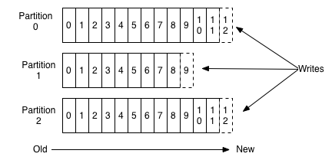
Topic & Logs
Offset
Data
A topic is a category or feed name to which records are published. For understanding we will take Topic Name as – PIZZA_ORDER
Topics in Kafka are always multi-subscriber; that is, a topic can have zero, one, or many consumers that subscribe to the data written to it. So we will have two subscribers to PIZZA_ORDER → CHEF and BILLING
0
1
2
3
4
5
6
7
8
9
10
Consumer A
(Offset 1)
For each topic, the Kafka cluster maintains a partitioned log that looks like this: →
Each partition is an ordered, immutable sequence of records that is continually appended to—a structured commit log.
Consumer B
(Offset 5)
Records have sequential ID – Offset
Durable Persistence of all records.
Configurable retention period
Constant performance of any data size.
Offset is controlled by the consumer
Producer
Topic – Partition N

Slide 8
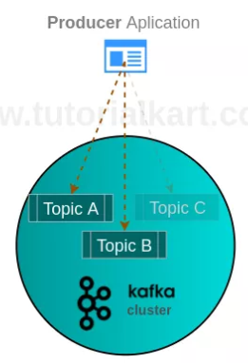
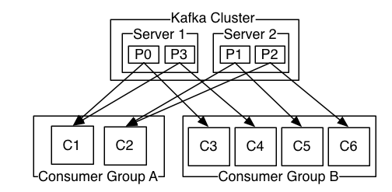
Producers, Consumer Groups and Partitions
Producers:
Producers publish data to the topics of their choice. The producer is responsible for choosing which record to assign to which partition within the topic.
Consumer Group
Consumer group is a multi-threaded or multi-machine consumption from Kafka topics. The connectivity of Consumer to Kafka Cluster is known using Heartbeat.
Consumers label themselves with a consumer group name
The maximum parallelism of a group is that the number of consumers in the group ← no of partitions.
Kafka assigns the partitions of a topic to the consumer in a group, so that each partition is consumed by exactly one consumer in the group.
Kafka guarantees that a message is only ever read by a single consumer in the group.
Consumers can see the message in the order they were stored in the log.

Slide 9
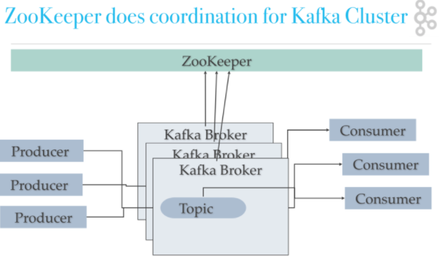
Kafka Cluster
The partitions of the log are distributed over the servers (brokers) in the Kafka cluster with each server handling data and requests for a share of the partitions. Each partition is replicated across a configurable number of servers for fault tolerance.
Each partition has one server which acts as the "leader" and zero or more servers which act as "followers".
The leader handles all read and write requests for the partition while the followers passively replicate the leader.
If the leader fails, one of the followers will automatically become the new leader.
Each server acts as a leader for some of its partitions and a follower for others so load is well balanced within the cluster.
Zookeeper also plays a vital role for serving many other purposes, such as leader detection, configuration management, synchronization, detecting when a new node joins or leaves the cluster, etc

Slide 10
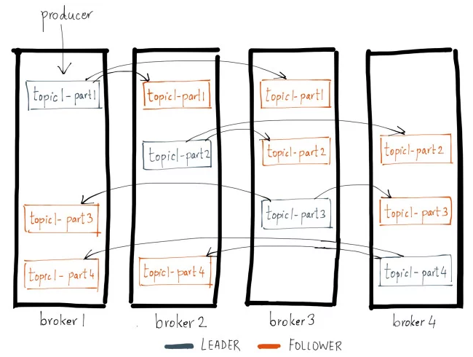
Replication
Every topic partition in Kafka is replicated n times, where n is the replication factor of the topic.
This allows Kafka to automatically failover to these replicas when a server in the cluster fails so that messages remain available in the presence of failures.
Out of the n replicas, one replica is designated as the leader while others are followers.
As the name suggests, the leadertakes the writes from the producer and the followers merely copy the leader’s log in order.

Slide 11
Is Kafka a new JMS?
Traditional MOM
Kafka
Slower Send and Receive operations (In general)
Messages gets removed once consumer receives it.
No Order guarantee.
Retry and replay mechanism needs external programming
Timing dependency on Consumer. If consumer is off, will not receive the messages published during that time
Cannot scale Subscribers.
Replication needs to be setup to achieve High Availability.
Really fast send and receive operations.
Messages will reside in topic till configured time
Consumer can peek the messages in Order.
Replay can be easily achieved by resetting offset.
No Timing dependency on Consumers. Consumer can come and go anytime. Consumer will start consuming the message from Last Offset count.
Consumers can be scaled within Consumer groups
Every Topic is replicated N times, where N is replication factor.
Messaging
Retry / Replay
Pub-Sub
Replication

Slide 12

Summary
Kafka is Fast, Reliable, Scalable, cutting edge solution for messaging over Tradition Queue based MOMs.
Kafka is Best to for Large scale messaging platform.
Kafka has more features than just messaging.

Slide 13
Kafka Use Cases
Better throughput, built-in partitioning, replication, and fault-tolerance,
Much more than normal message broker
Good solution for large-scale message processing applications.
Messaging
Activity Tracking
Original Use Case of Kafka is real-time publish-subscribe feeds.
Subscription Can be real-time processing, real-time monitoring, loading in Hadoop for offline processing and reporting.
Metrics
Operation monitoring data pipelines.
Aggregating statistics from distributed applications to produce centralized feeds of operational data.
Log Aggregation
Collects physical log files off servers, and puts them in a central place (a file server or HDFS perhaps) for processing.
Read data from topic - aggregated, enriched, or otherwise transformed into new topics for further consumption
Kafka’s strong durability is also very useful
Stream Processing
Event Sourcing
Kafka is excellent choice for Event Driven Development Model
Acts as external commit log for distributed System
Also, acts as a re-syncing mechanism for failed nodes to restore their data.
Commit Log

Slide 14
Thank You

